Slide 1
IPL AUCTION PROJECT
Formulating an auction strategy for a new IPL franchise by examining past IPL data to build a strong and balanced squad

Slide 2
Create Table Query for IPL_BALL csv file
CREATE TABLE ipl_ball (id integer, inning integer, over integer, ball integer, batsman varchar(255), non_striker varchar(255), bowler varchar(255), batsman_run integer, extra_run integer, total_run integer, is_wicket integer, dissmissal_kind varchar(255), player_dismissed varchar(255), fielder varchar(255), extras_type varchar(255), batting_team varchar(255), bowling_team varchar(255));
IMPORTING CSV file in the table via copy command COPY ipl_ball from 'C:\Program Files\PostgreSQL\16\data\Data_Copy\IPL Dataset\IPL_Ball.csv' delimiter ',' csv header;

Slide 3
Create Table Query for IPL_MATCHES csv file
CREATE TABLE IPL_MATCHES (ID INTEGER , CITY VARCHAR(255), MATCH_DATE DATE, PLAYER_OF_MATCH VARCHAR(255), VENUE VARCHAR(255), NEUTRAL_VENUE INTEGER, TEAM1 VARCHAR(255), TEAM2 VARCHAR(255), TOSS_WINNER VARCHAR(255), TOSS_DECISION VARCHAR(255), WINNER VARCHAR(255), RESULT VARCHAR(255), RESULT_MARGIN INTEGER, ELIMINATOR VARCHAR(255), METHOD VARCHAR(255), UMPIRE1 VARCHAR(255), UMPIRE2 VARCHAR(255) );
Importing IPL_MATCHES CSV file via COPY command COPY IPL_MATCHES FROM 'C:\Program Files\PostgreSQL\16\data\Data_Copy\IPL Dataset\IPL_matches.csv' DELIMITER ',' CSV HEADER;

Slide 4

Task 1 – To make a list of 10 players with Higher Strike-Rate
SELECT BATSMAN , SUM(BATSMAN_RUN) AS TOT_RUN_SCORED , COUNT(BALL) AS FACED_BALL,
ROUND((SUM(BATSMAN_RUN)*100)/COUNT(BALL), 2) AS STRIKE_RATE FROM IPL_BALL
GROUP BY BATSMAN HAVING COUNT(BALL)>500
ORDER BY STRIKE_RATE DESC LIMIT 10;

Slide 5
Task – 1 Query Result
batsman | tot_run_scored | faced_ball | strike_rate
AD Russell | 1517 | 882 | 171
SP Narine | 892 | 573 | 155
HH Pandya | 1349 | 897 | 150
V Sehwag | 2728 | 1833 | 148
GJ Maxwell | 1505 | 1013 | 148
AB de Villiers | 4849 | 3264 | 148
RR Pant | 2079 | 1416 | 146
JC Buttler | 1714 | 1184 | 144
KA Pollard | 3023 | 2107 | 143
CH Gayle | 4772 | 3342 | 142

Slide 6
Task – 1 Visualization of Strike Rate

Slide 7

Task 2 - To make a list of 10 players with Good Average who have played more than 2 IPL seasons
Select A.Batsman , Count(distinct(extract(year from B.match_date))) As Season_played ,
ROUND(Sum(A.batsman_run) * 1.0/ Count(case when A.is_wicket = 1 then A.is_wicket end),2) As Batting_average
From IPL_Ball As A Left Join IPl_Matches AS B on A.ID = B.ID
Group By A.Batsman
Having Count(distinct(extract(year from B.match_date))) > 2 Order By Batting_average desc limit 10;

Slide 8
Task – 2 Query Result
batsman | season_played | batting_average
Iqbal Abdulla | 8 | 88
KL Rahul | 7 | 42.69
AB de Villiers | 13 | 42.54
DA Warner | 11 | 41.7
JP Duminy | 8 | 41.41
CH Gayle | 12 | 41.14
ML Hayden | 3 | 41
LMP Simmons | 4 | 39.96
KS Williamson | 6 | 39.49
OA Shah | 4 | 38.92

Slide 9
Task – 2 Visualization Of players with Good Average who have played more than 2 IPL seasons

Slide 10

Task 3 – To make list of 10 hard-hitting players who have scored more runs in boundaries and have played more than 2 IPL seasons
Select A.Batsman ,
Sum(case When A.Batsman_run in (4 ,6) then 1 else 0 end) as Total_Boundaries ,
Sum(A.Batsman_run) As Run_Scored ,
Round(Sum(case when A.Batsman_run in (4,6) then A.Batsman_run end)*1.0 / sum(A.Batsman_run)*100 , 2) As Boundary_percentage
from IPL_BALL As A Left Join IPL_MATCHES As B on A.ID = B.ID
Group By A.Batsman
having Count(Distinct(Extract(year from B.match_date))) > 2
Order By Total_Boundaries Desc limit 10;

Slide 11
Task – 3 Query Result
batsman | run_scored | run_in_boundaries | total_boundaries | boundary_percentage
CH Gayle | 4772 | 3630 | 733 | 76.07
V Kohli | 5878 | 3228 | 706 | 54.92
DA Warner | 5254 | 3210 | 705 | 61.1
S Dhawan | 5197 | 3018 | 700 | 58.07
SK Raina | 5368 | 3136 | 687 | 58.42
RG Sharma | 5230 | 3116 | 672 | 59.58
AB de Villiers | 4849 | 2970 | 625 | 61.25
RV Uthappa | 4607 | 2794 | 617 | 60.65
SR Watson | 3874 | 2644 | 566 | 68.25
G Gambhir | 4217 | 2322 | 551 | 55.06

Slide 12
Task – 3 Visualization

Slide 13

Task – 4 To make a list of 10 players with Good Economy Have Bowled > 500
Select Bowler, Sum(total_run) As Run_Conceded , Count(Ball) As Ball_Bowled,
Round(Sum(total_run) / (Count(Ball)/6.0) , 2) As Economy
From IPL_BALL
Group By Bowler
Having Count(Ball)>500
Order By Economy Asc limit 10;

Slide 14
Task – 4 Query Result
bowler | run_conceded | ball_bowled | economy
Rashid Khan | 1573 | 1490 | 6.33
A Kumble | 1089 | 983 | 6.65
M Muralitharan | 1755 | 1577 | 6.68
DW Steyn | 2568 | 2276 | 6.77
R Ashwin | 3756 | 3327 | 6.77
SP Narine | 3208 | 2824 | 6.82
DL Vettori | 894 | 785 | 6.83
Washington Sundar | 758 | 660 | 6.89
J Botha | 818 | 709 | 6.92
R Tewatia | 684 | 587 | 6.99

Slide 15
Task – 4 Visualization

Slide 16

Task – 5 To make list of top 10 players with best strike rate and who have bowled at least 500 balls in IPL
Select Bowler, Count(Ball) As No_Of_Ball_Bowled ,
Sum(Case when is_wicket = 1 then 1 else 0 end ) As Wicket_taken ,
Round(Count(Ball) * 1.0/(Sum(Case when is_wicket = 1 then 1 else 0 end )),2) As Bowler_Strike_rate
from IPL_BALL Group By Bowler
Having Count(Ball) >= 500
Order By Bowler_Strike_rate ASC Limit 10;

Slide 17
Task – 5 Query Result
bowler | no_of_ball_bowled | wicket_taken | bowler_strike_rate
K Rabada | 840 | 66 | 12.73
DE Bollinger | 600 | 43 | 13.95
AJ Tye | 645 | 45 | 14.33
MA Starc | 612 | 39 | 15.69
SL Malinga | 2974 | 188 | 15.82
Imran Tahir | 1314 | 83 | 15.83
DJ Bravo | 2846 | 175 | 16.26
A Nehra | 1974 | 121 | 16.31
S Aravind | 788 | 48 | 16.42
KK Cooper | 600 | 36 | 16.67

Slide 18
Task -5 Visualization

Slide 19
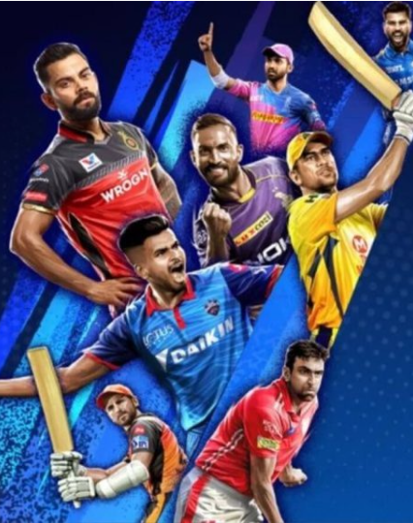
Task 6 – To make a list of all-rounder players with the best batting as well as bowling strike rate and who have faced at least 500 balls in IPL so far and have bowled minimum 300 particular player.
Select A.Bowler As All_Rounder , A.Strike_rate As Bowler_strikerate , B.Strike_rate As Batsman_strikerate
from (Select Bowler, Count(Ball) As No_Of_Ball_Bowled ,
Sum(Case when is_wicket = 1 then 1 else 0 end ) As Wicket_taken ,
Round(Count(Ball) * 1.0/(Sum(Case when is_wicket = 1 then 1 else 0 end )),2) As Strike_rate
from IPL_BALL Group By Bowler
Having Count(Ball) >= 300
Order By Strike_rate ASC ) As A inner join (SELECT BATSMAN , SUM(BATSMAN_RUN) AS TOT_RUN_SCORED , COUNT(BALL) AS FACED_BALL,
ROUND((SUM(BATSMAN_RUN)*100)/COUNT(BALL), 2) AS STRIKE_RATE FROM IPL_BALL
GROUP BY BATSMAN HAVING COUNT(BALL)>500
ORDER BY STRIKE_RATE DESC) As B on A.Bowler = B.Batsman limit 10;

Slide 20
Task – 6 Query Result
all_rounder | bowler_strikerate | batsman_strikerate
AD Russell | 17.7 | 171
SP Narine | 19.75 | 155
HH Pandya | 20.31 | 150
GJ Maxwell | 27.9 | 148
KA Pollard | 19.92 | 143
CH Gayle | 30.74 | 142
YK Pathan | 25.74 | 137
KH Pandya | 26.18 | 137
JA Morkel | 18.82 | 136
ST Jayasuriya | 18.81 | 134

Slide 21
Task – 6 Visualization

Slide 22
Task – 7 Criteria for Choosing the Best Wicketkeepers:
Good Batting Average: Consistently scoring a significant number of runs per innings.
Good Strike Rate: Scoring runs at a quick pace, essential in limited-overs formats.
Hard-Hitter: Ability to score boundaries and play aggressive shots when needed.
Number of Stumping Dismissals: Proficiency in quick stumpings, indicating sharp reflexes and agility.
Number of Caught Behind Dismissals: Effectiveness in catching behind the stumps, showcasing safe hands and anticipation.
Past Experience: Proven track record and performance history in various match situations.
Availability or Comparison with Another Wicketkeeper: Considering the player's availability and comparing their skills and performance with other potential wicketkeepers.

Slide 23

Additional Questions

Slide 24
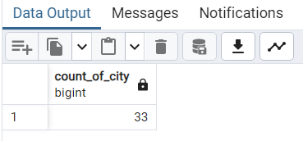
1. Get the count of cities that have hosted an IPL match
Query
Select count(Distinct(city)) As Count_Of_city from IPL_Matches;

Slide 25

2. Create table deliveries_v02 with all the columns of the table ‘deliveries’ and an additional column ball_result containing values boundary, dot or other depending on the total_run (boundary for >= 4, dot for 0 and other for any other number)
with Deliveries_v02 as
( select * ,
(case when total_run >= 4 then 'Boundary' When total_run = 0 then 'Dot' else 'Other' end ) As Ball_result from IPL_BALL)
Select * from Deliveries_v02;

Slide 26
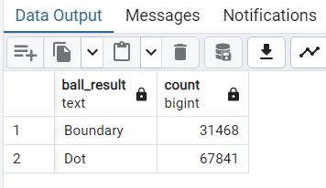
3. Write a query to fetch the total number of boundaries and dot balls from the deliveries_v02 table
SELECT ball_result, COUNT(ball_result) FROM deliveries_v02
GROUP BY ball_result HAVING ball_result IN('Boundary', 'Dot' );

Slide 27

4. Write a query to fetch the total number of boundaries scored by each team from the deliveries_v02 table and order it in descending order of the number of boundaries scored.
select Batting_team , Count(Ball_result)As No_Of_Boundary
from Deliveries_v02
where Ball_Result = 'Boundary'
group by Batting_team
order by No_Of_Boundary desc;

Slide 28
4. Query Result
batting_team | no_of_boundary
Mumbai Indians | 4118
Royal Challengers Bangalore | 3800
Kings XI Punjab | 3780
Kolkata Knight Riders | 3739
Chennai Super Kings | 3496
Rajasthan Royals | 3041
Delhi Daredevils | 3022
Sunrisers Hyderabad | 2306
Deccan Chargers | 1387
Pune Warriors | 733
Delhi Capitals | 659
Gujarat Lions | 624
Rising Pune Supergiant | 290
Rising Pune Supergiants | 242
Kochi Tuskers Kerala | 231

Slide 29

5. Write a query to fetch the total number of dot balls bowled by each team and order it in descending order of the total number of dot balls bowled
select Batting_team , Count(Ball_result)As No_Of_Dot_Ball
from Deliveries_v02
where Ball_Result = 'Dot'
group by Batting_team
order by No_Of_Dot_Ball desc;

Slide 30
5. Query Result
batting_team | no_of_dot_ball
Mumbai Indians | 8756
Kolkata Knight Riders | 8017
Royal Challengers Bangalore | 7988
Kings XI Punjab | 7858
Chennai Super Kings | 7389
Rajasthan Royals | 6762
Delhi Daredevils | 6592
Sunrisers Hyderabad | 4944
Deccan Chargers | 3227
Pune Warriors | 2099
Delhi Capitals | 1324
Gujarat Lions | 1153
Rising Pune Supergiant | 616
Kochi Tuskers Kerala | 595
Rising Pune Supergiants | 521

Slide 31
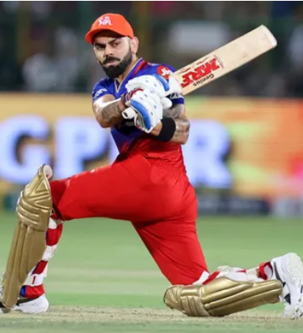
6. Write a query to fetch the total number of dismissals by dismissal kinds where dismissal kind is not NA
Select Dissmissal_kind , Count(dissmissal_kind) As No_of_Dissmissal from Deliveries_v02
where dissmissal_kind != 'NA'
group by Dissmissal_kind
Order By No_of_Dissmissal desc;

Slide 32
6. Query Result
dissmissal_kind | no_of_dissmissal
caught | 5743
bowled | 1700
run out | 893
lbw | 571
stumped | 294
caught and bowled | 269
hit wicket | 12
retired hurt | 11
obstructing the field | 2

Slide 33
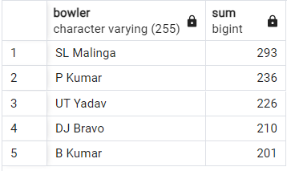
7. Write a query to get the top 5 bowlers who conceded maximum extra runs from the deliveries table
Select Bowler, Sum(extra_run) FROM Deliveries_v02 group by Bowler order by Sum(Extra_run) desc limit 5;

Slide 34
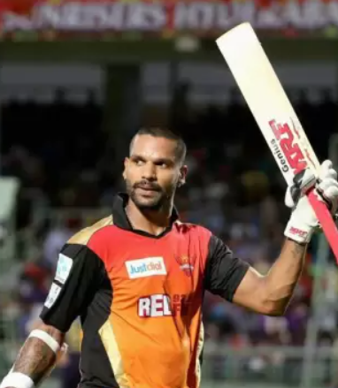
8. Write a query to create a table named deliveries_v03 with all the columns of deliveries_v02 table and two additional column (named venue and match_date) of venue and date from table matches
with deliveries_v03 as (
select *,
B.venue , B.match_date from deliveries_v02 As A right join IPL_Matches As B on A.id = B.id
)
SELECT * FROM Deliveries_v03;

Slide 35
9. Write a query to fetch the total runs scored for each venue and order it in the descending order of total runs scored.
SELECT venue,
SUM(total_runs) AS runs_scored
FROM deliveries_v03
GROUP BY venue
ORDER BY runs_scored DESC;

Slide 36
9. Query Result
venue | runs_scored
Eden Gardens | 23658
Wankhede Stadium | 23390
Feroz Shah Kotla | 22947
M Chinnaswamy Stadium | 20237
Rajiv Gandhi International Stadium, Uppal | 19484
MA Chidambaram Stadium, Chepauk | 17821
Sawai Mansingh Stadium | 14264
Punjab Cricket Association Stadium, Mohali | 10987
Dubai International Cricket Stadium | 10402
Sheikh Zayed Stadium | 8830
Punjab Cricket Association IS Bindra Stadium, Mohali | 7021
Maharashtra Cricket Association Stadium | 6780
Sharjah Cricket Stadium | 5924
M.Chinnaswamy Stadium | 5127
Dr DY Patil Sports Academy | 4810
Subrata Roy Sahara Stadium | 4755
Kingsmead | 4353
Brabourne Stadium | 3842
Dr. Y.S. Rajasekhara Reddy ACA-VDCA Cricket Stadium | 3746
Sardar Patel Stadium, Motera | 3746
SuperSport Park | 3653
Saurashtra Cricket Association Stadium | 3316
Himachal Pradesh Cricket Association Stadium | 2897
Holkar Cricket Stadium | 2872
New Wanderers Stadium | 2292
Barabati Stadium | 2278
JSCA International Stadium Complex | 2056
St George's Park | 2033
Newlands | 1764
Shaheed Veer Narayan Singh International Stadium | 1741
Nehru Stadium | 1363
Green Park | 1298
De Beers Diamond Oval | 897
Vidarbha Cricket Association Stadium, Jamtha | 882
Buffalo Park | 799
OUTsurance Oval | 529

Slide 37

10. Write a query to fetch the year-wise total runs scored at Eden Gardens and order it in the descending order of total runs scored.
Select Distinct(Extract(year from match_date)) As M_date , Sum(Total_run) as Total_Score from deliveries_v03
where venue = 'Eden Gardens' group by M_date order by Total_Score desc;

Slide 38
10. Query Result
m_date | total_score
2018 | 2885
2019 | 2651
2015 | 2386
2013 | 2304
2017 | 2194
2010 | 2167
2016 | 2073
2012 | 2012
2011 | 1854
2008 | 1843
2014 | 1289

Slide 39

Thank You

